Slide 1
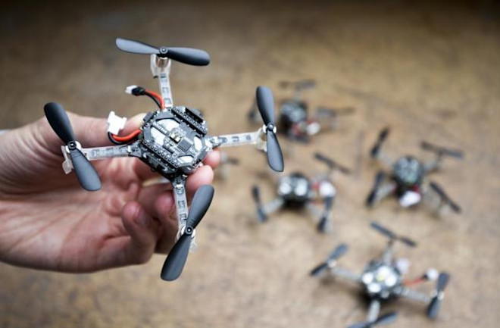
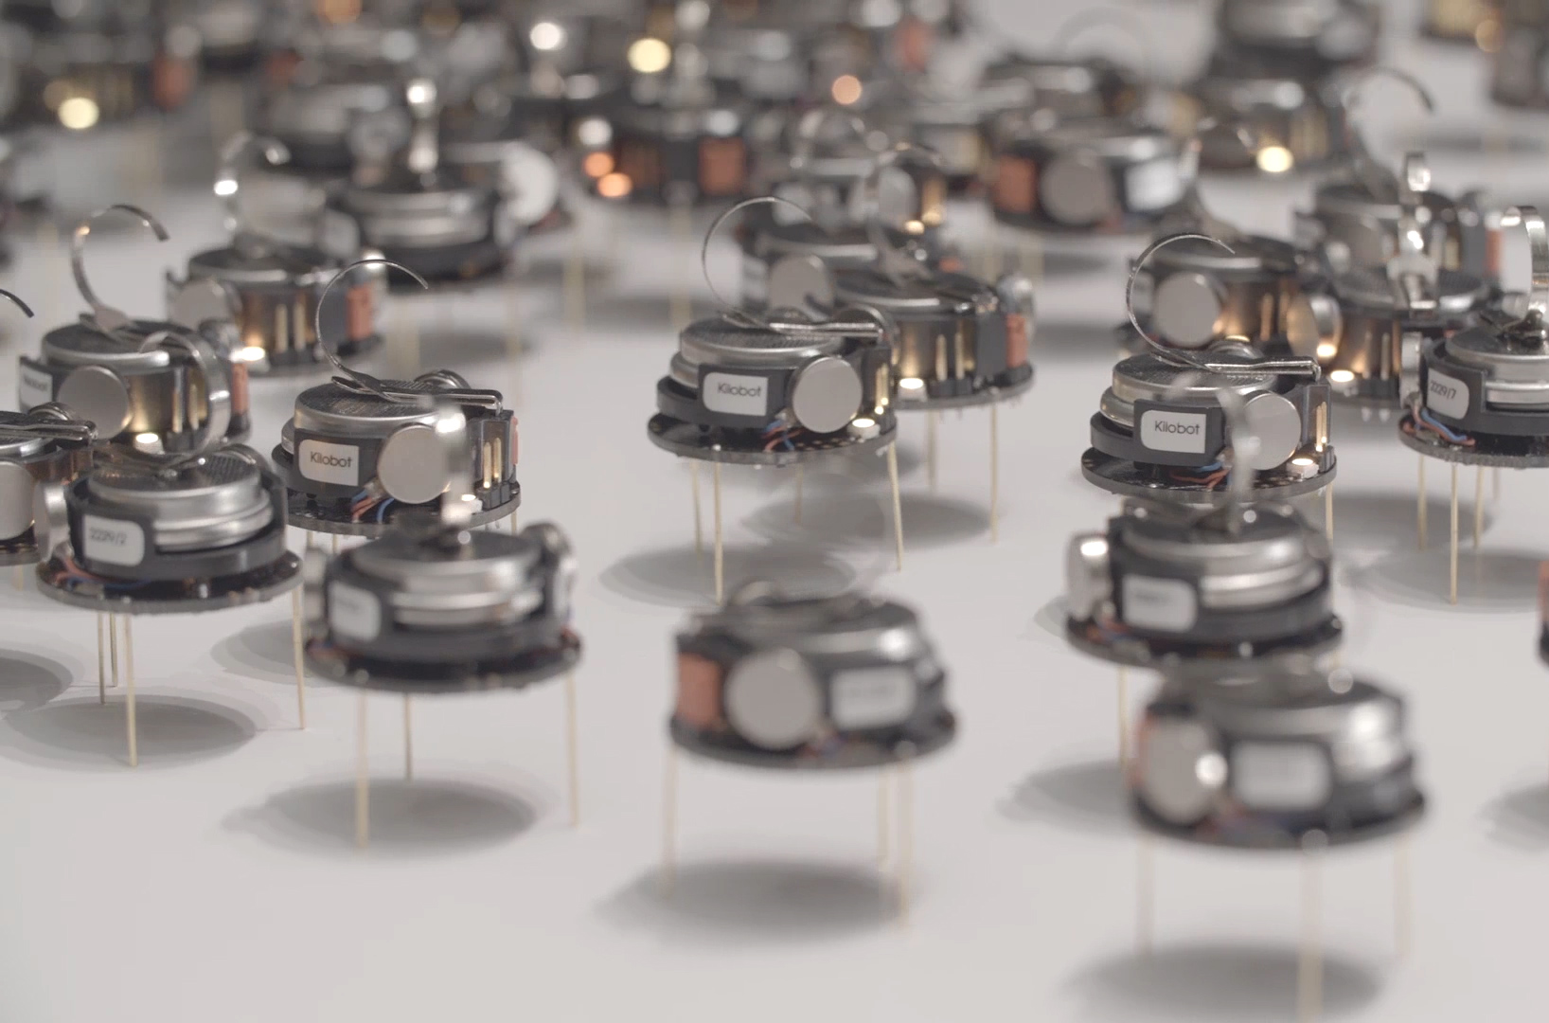
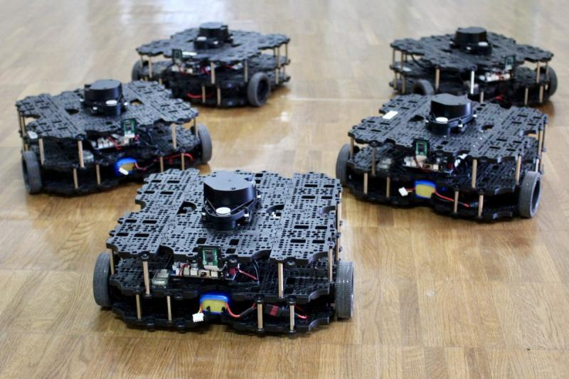

ECE693H, Spring 2025: Multi-robot System Design
“Intelligence 1”
Dr. Daniel Drew

Slide 2
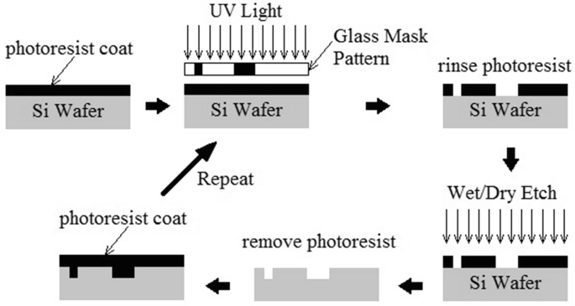
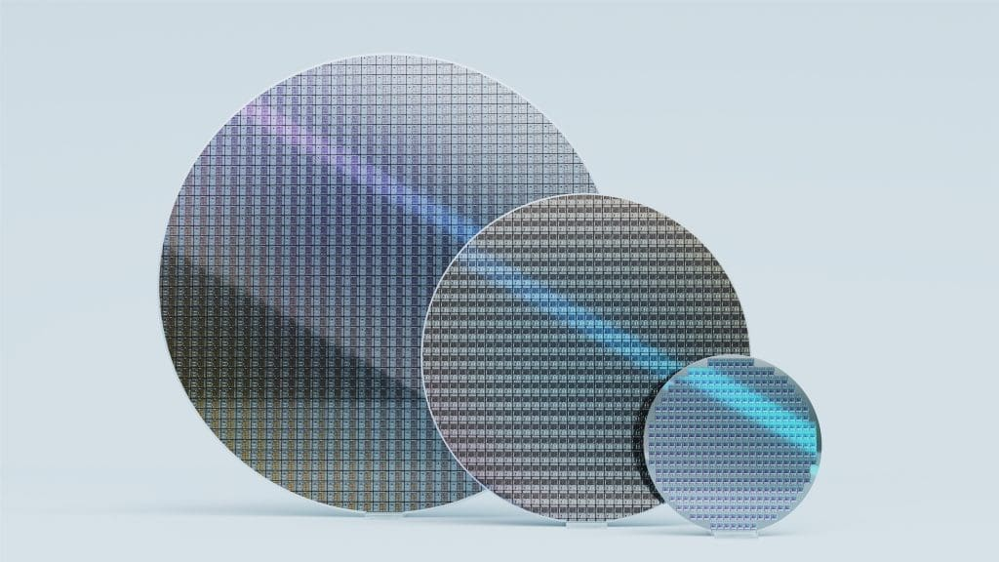
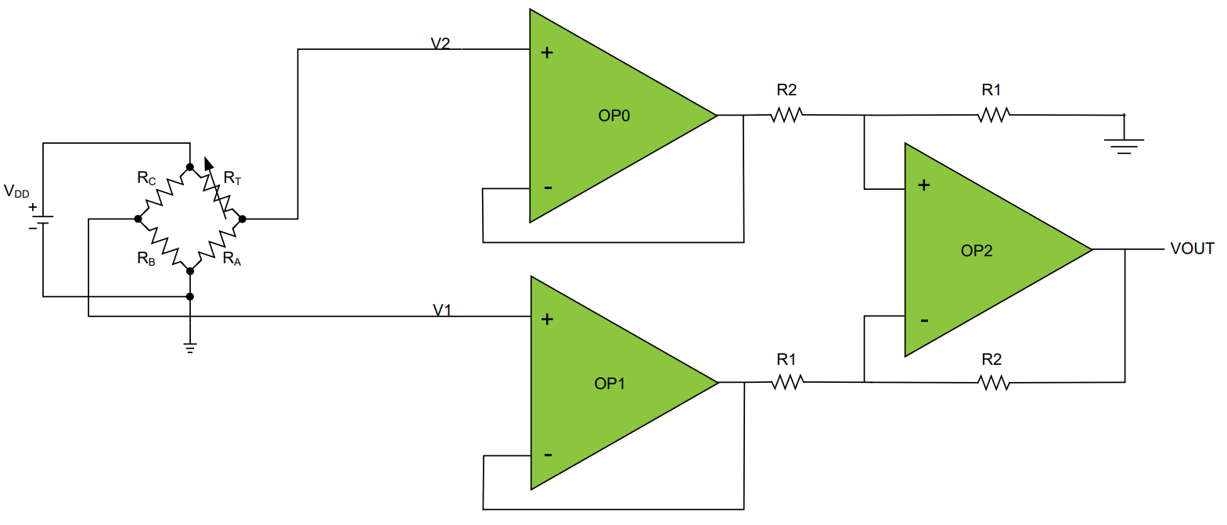
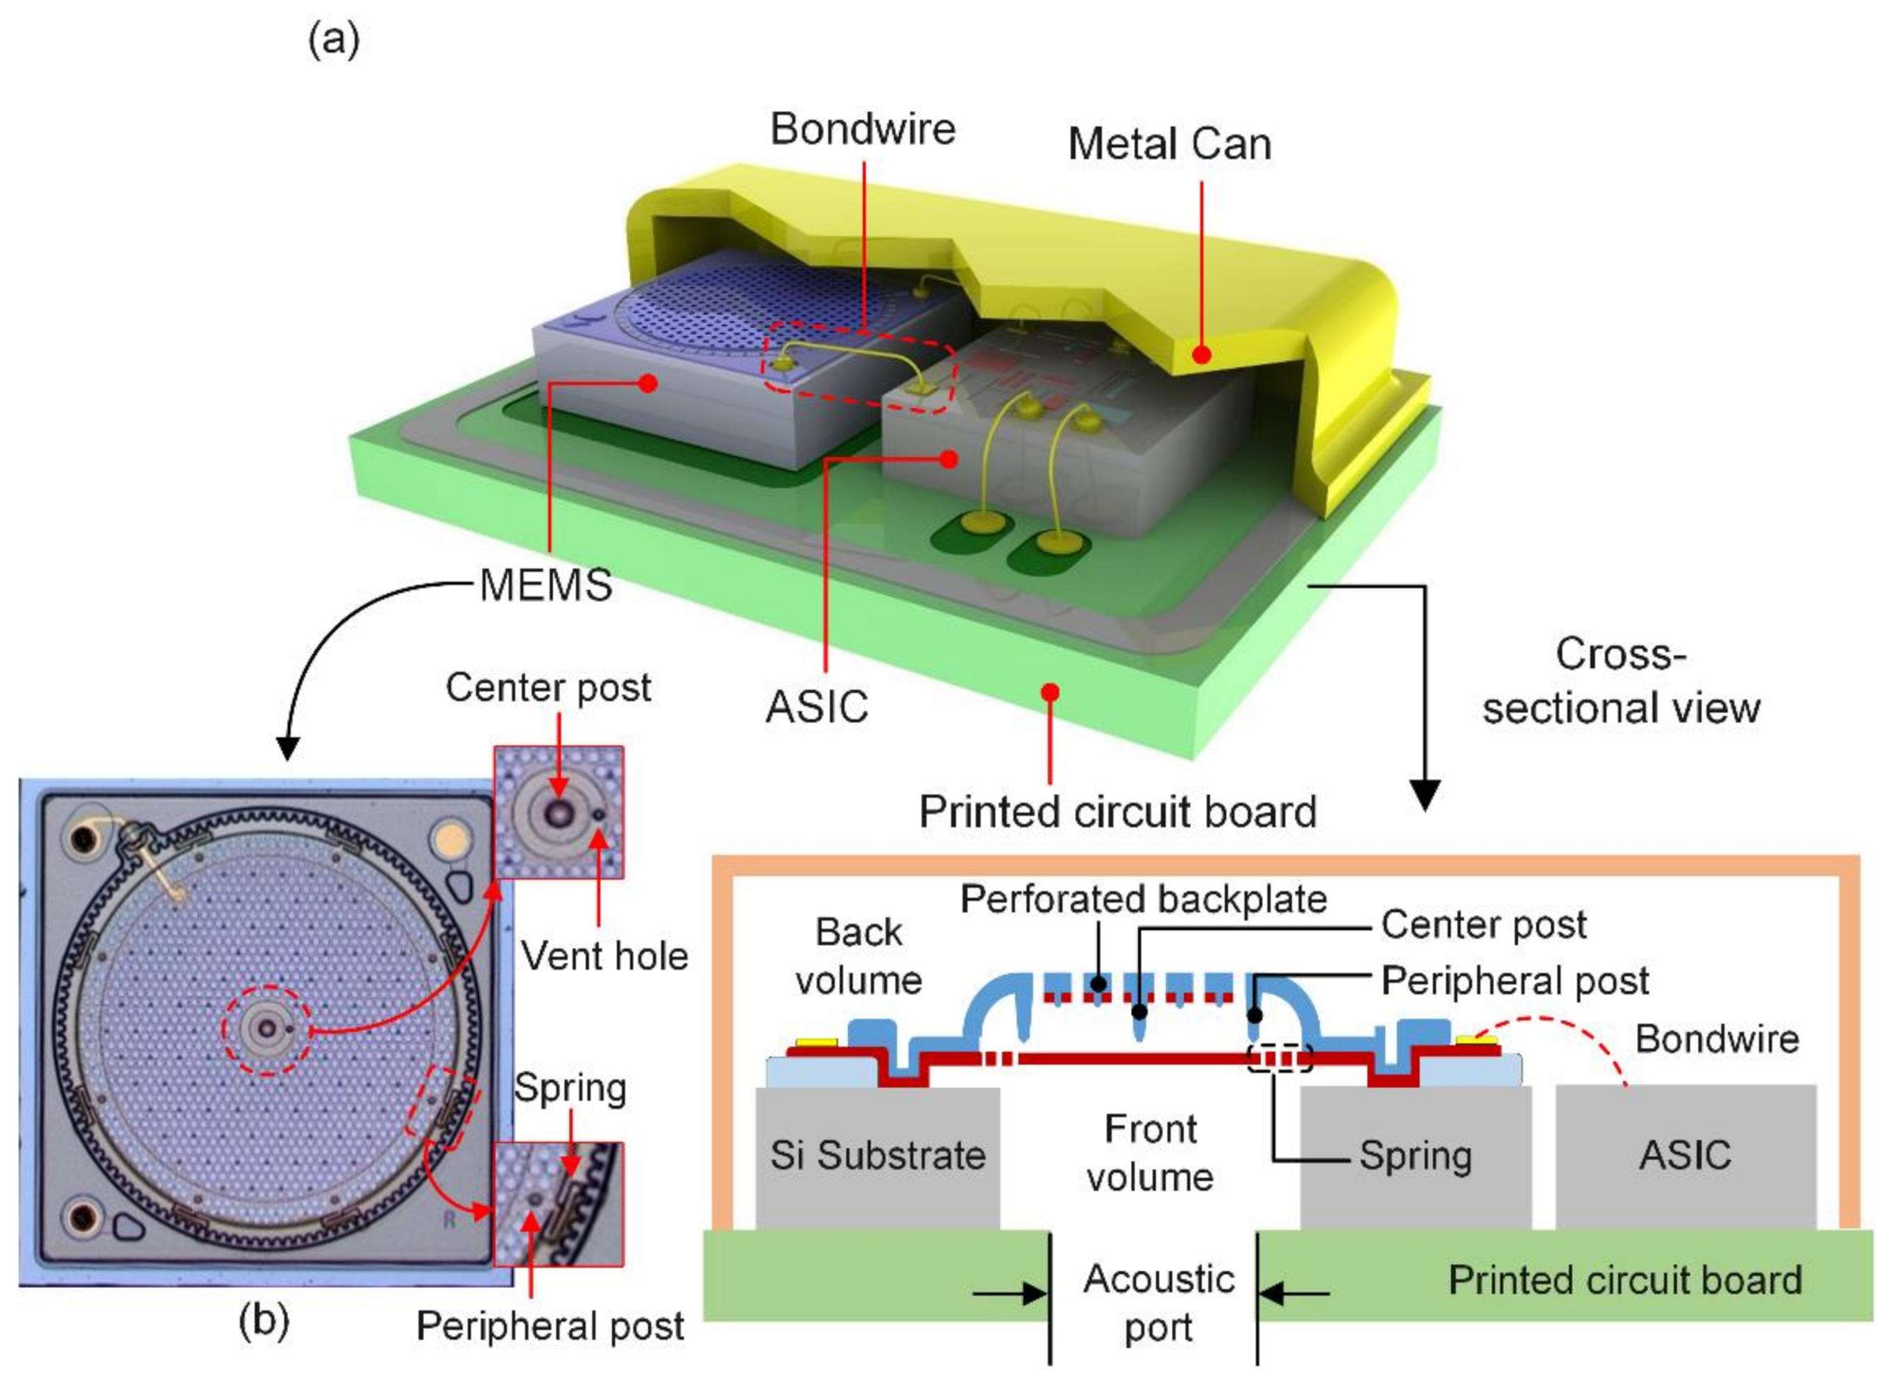
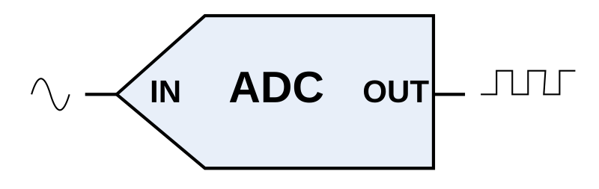
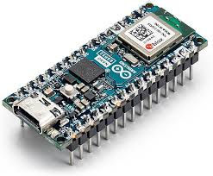
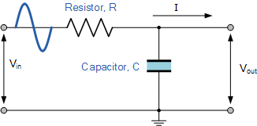
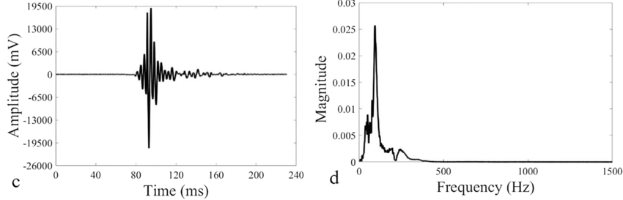
Perception Recap

Slide 3
Questions?

Slide 4
Class Overview
Lecture (~40 minutes)
Subsystem check-in (~20 minutes)

Slide 5
Intelligence: Lecture 1 of 2
Lecture 1: features, transformations, and mapping
Lecture 2: SLAM

Slide 6
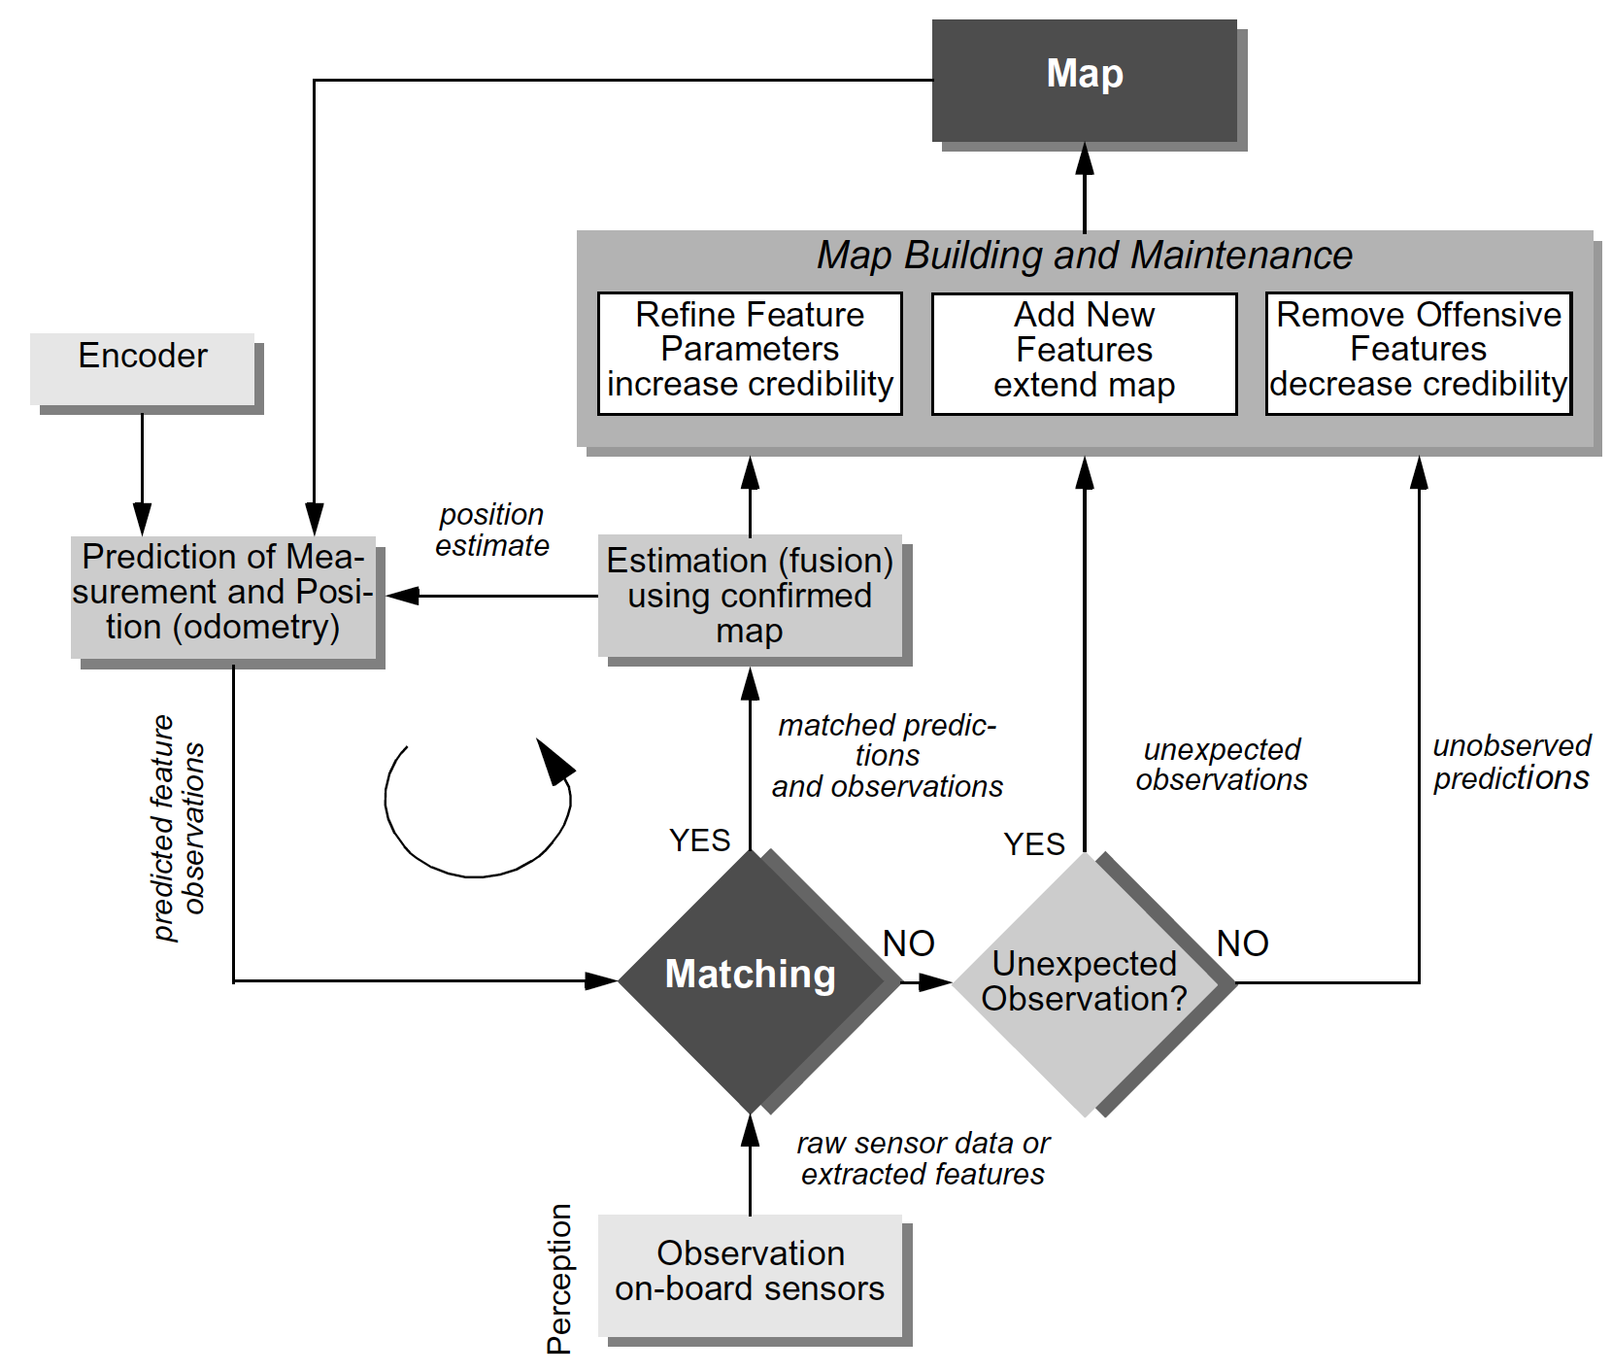
SLAM as an archetypical function
Mapping,
Feedback between Action and Perception
Localization
Perception

Slide 7
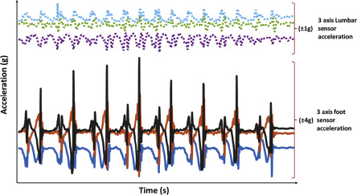
From Data to Features

Slide 8
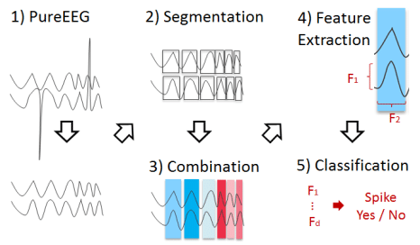
From Data to Features

Slide 9
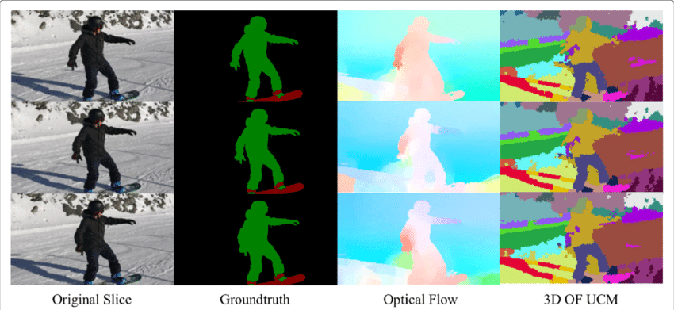
From Data to Features

Slide 10
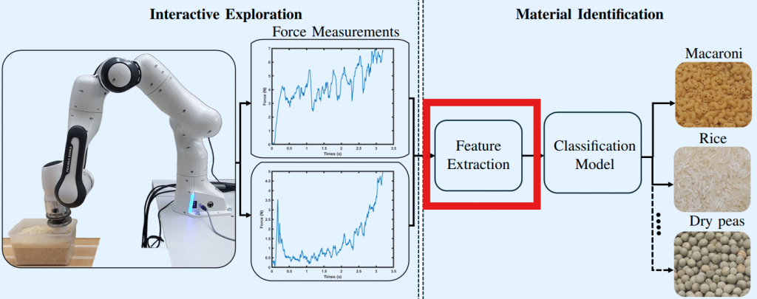
From Data to Features

Slide 11
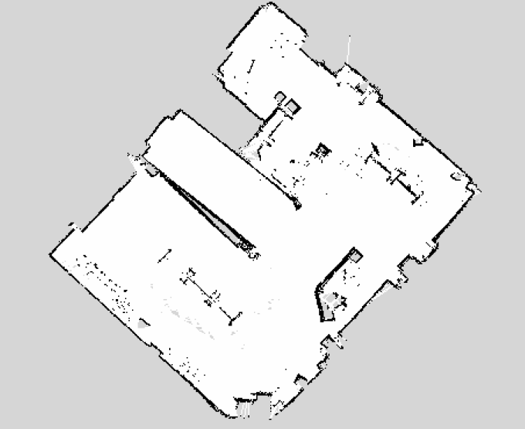
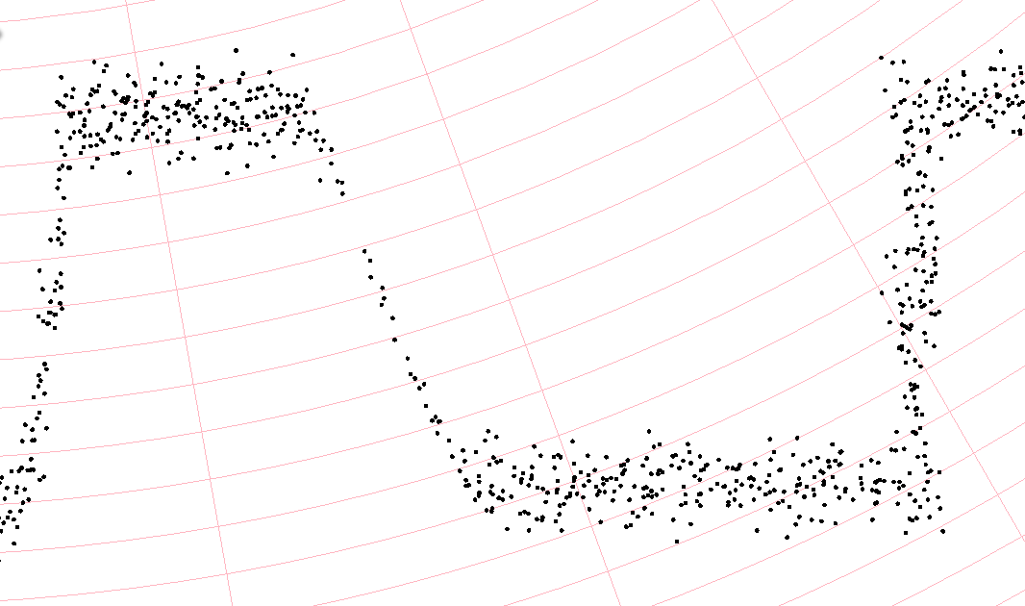
Features: Edges
How do we turn this into “walls” -- algorithmically?

Slide 12
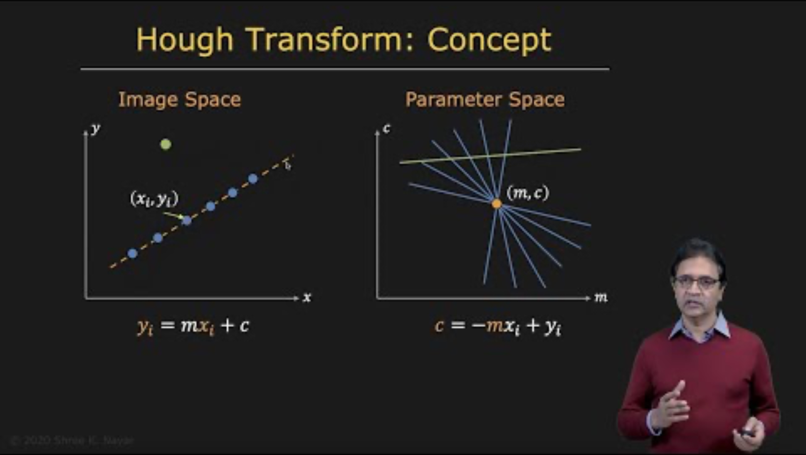
Features: Edges

Slide 13
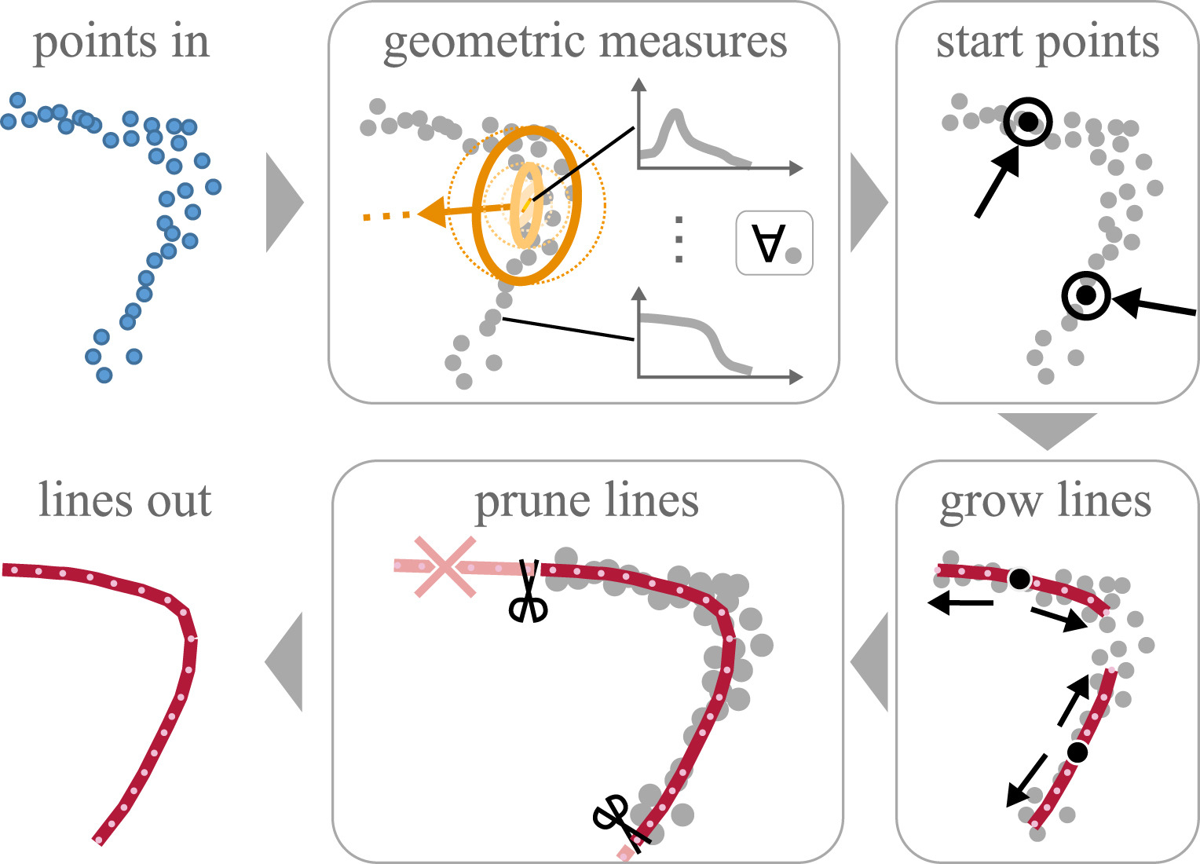
Features: Curved Edges
Generalized Hough Transform (GHT) works for curves – but expensive.
Alternatives are in research:

Slide 14
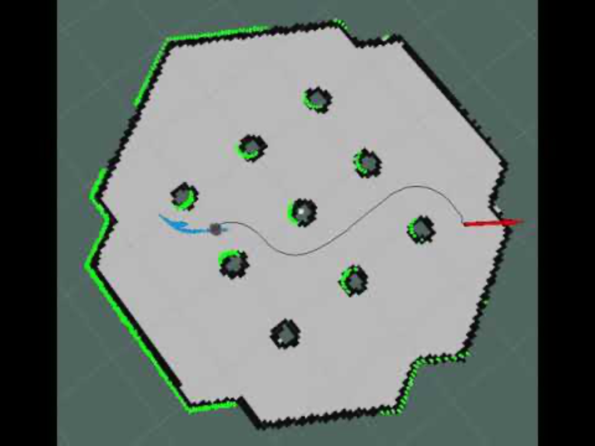
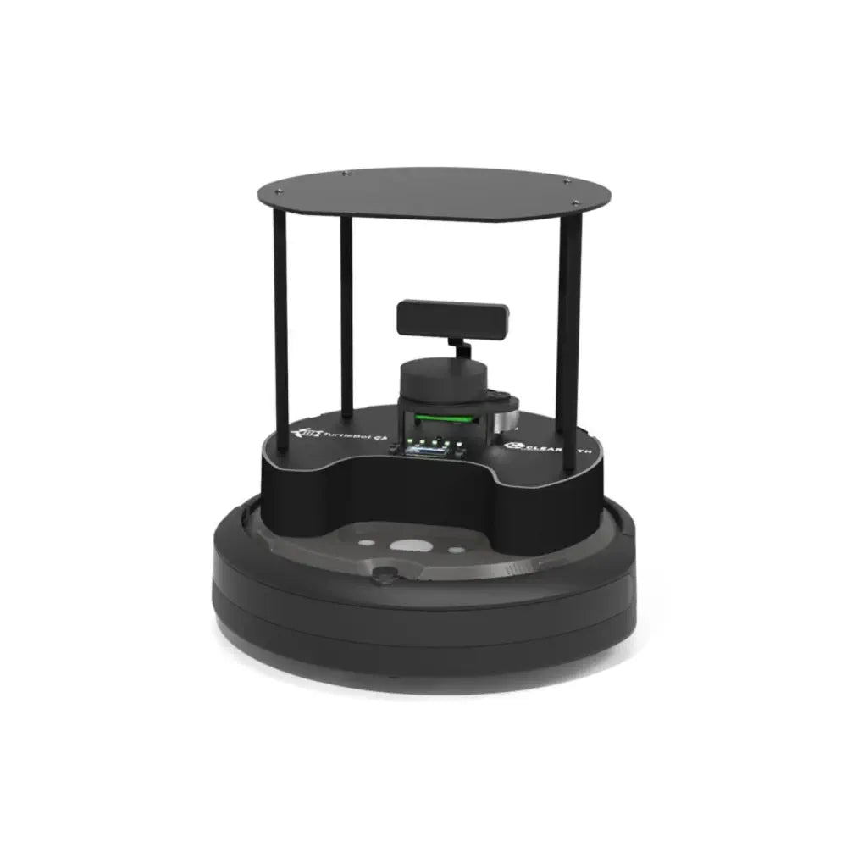

Slide 15
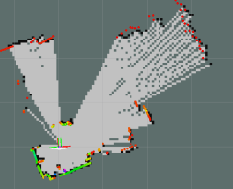
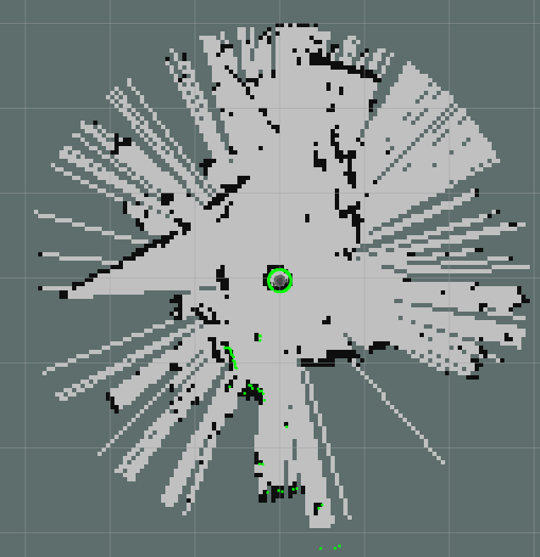
Features: Gone Wrong

Slide 16
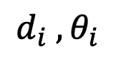
The World Frame
$$d_{i} , θ_{i}$$
(0,0)

Slide 17
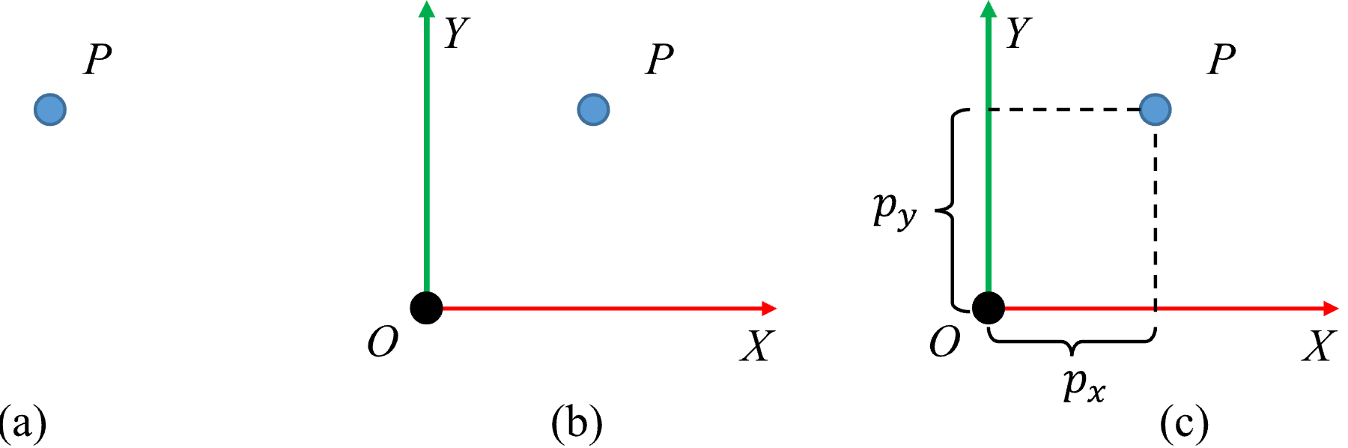
Coordinate Frames
A point means nothing without a reference coordinate frame

Slide 18
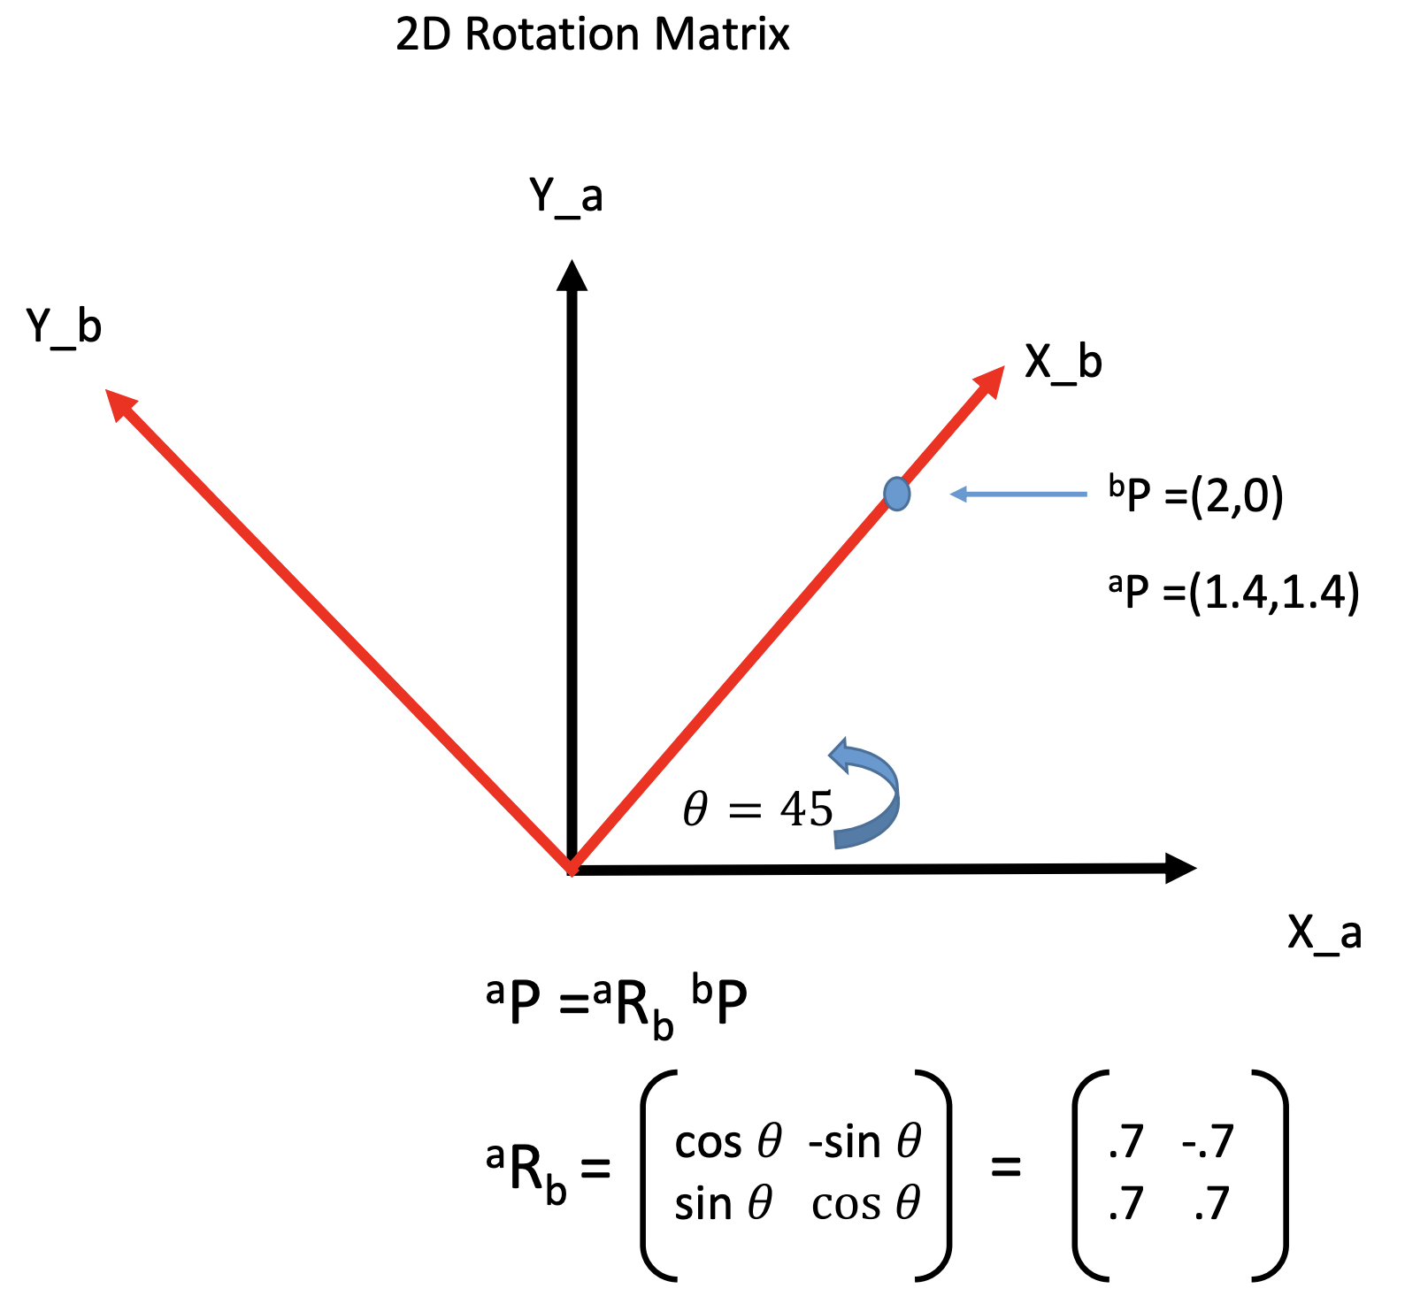
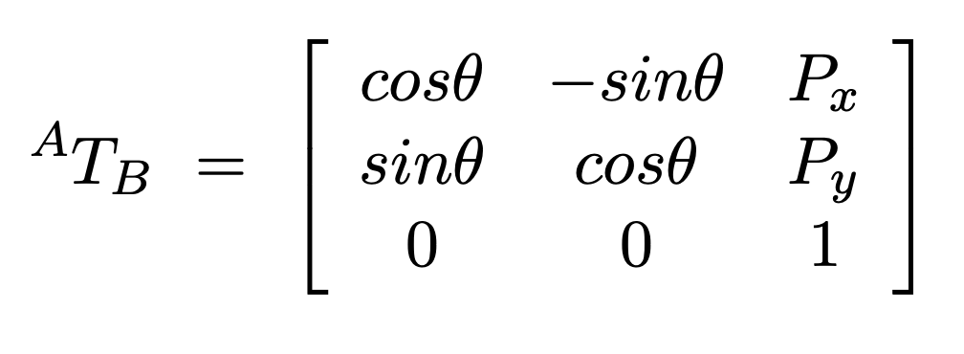
Frame Transformations: Rotation
(rotates b to a)
https://www.cs.columbia.edu/~allen/F17/NOTES/frames2.pdf

Slide 19
Frame Transformations: Adding Translation

Slide 20
Frame Transformations: Successive Transforms
World frame -> robot frame -> sensor frame

Slide 21
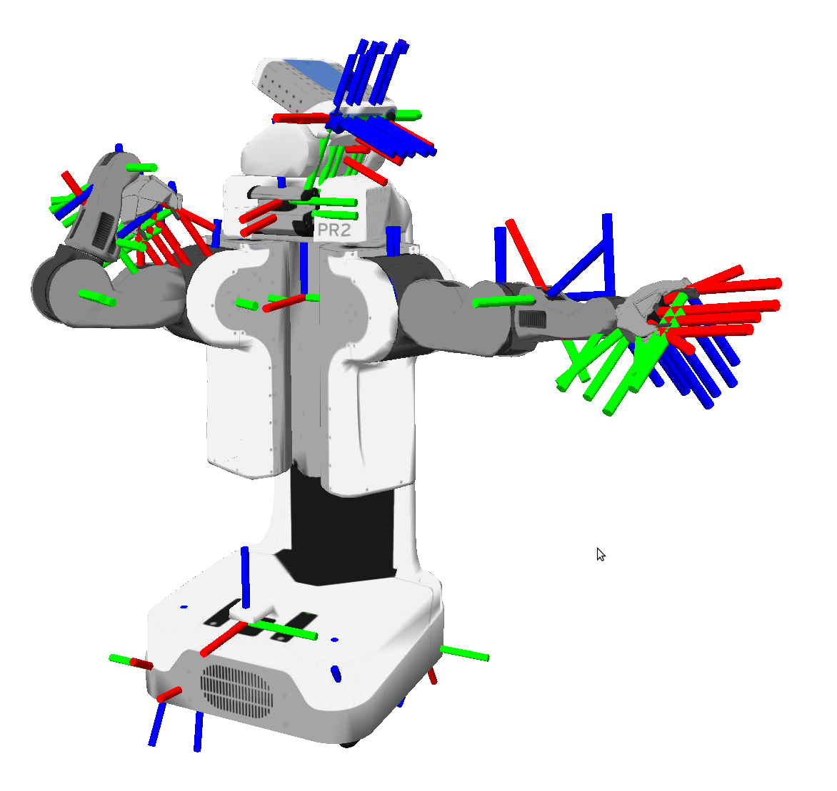
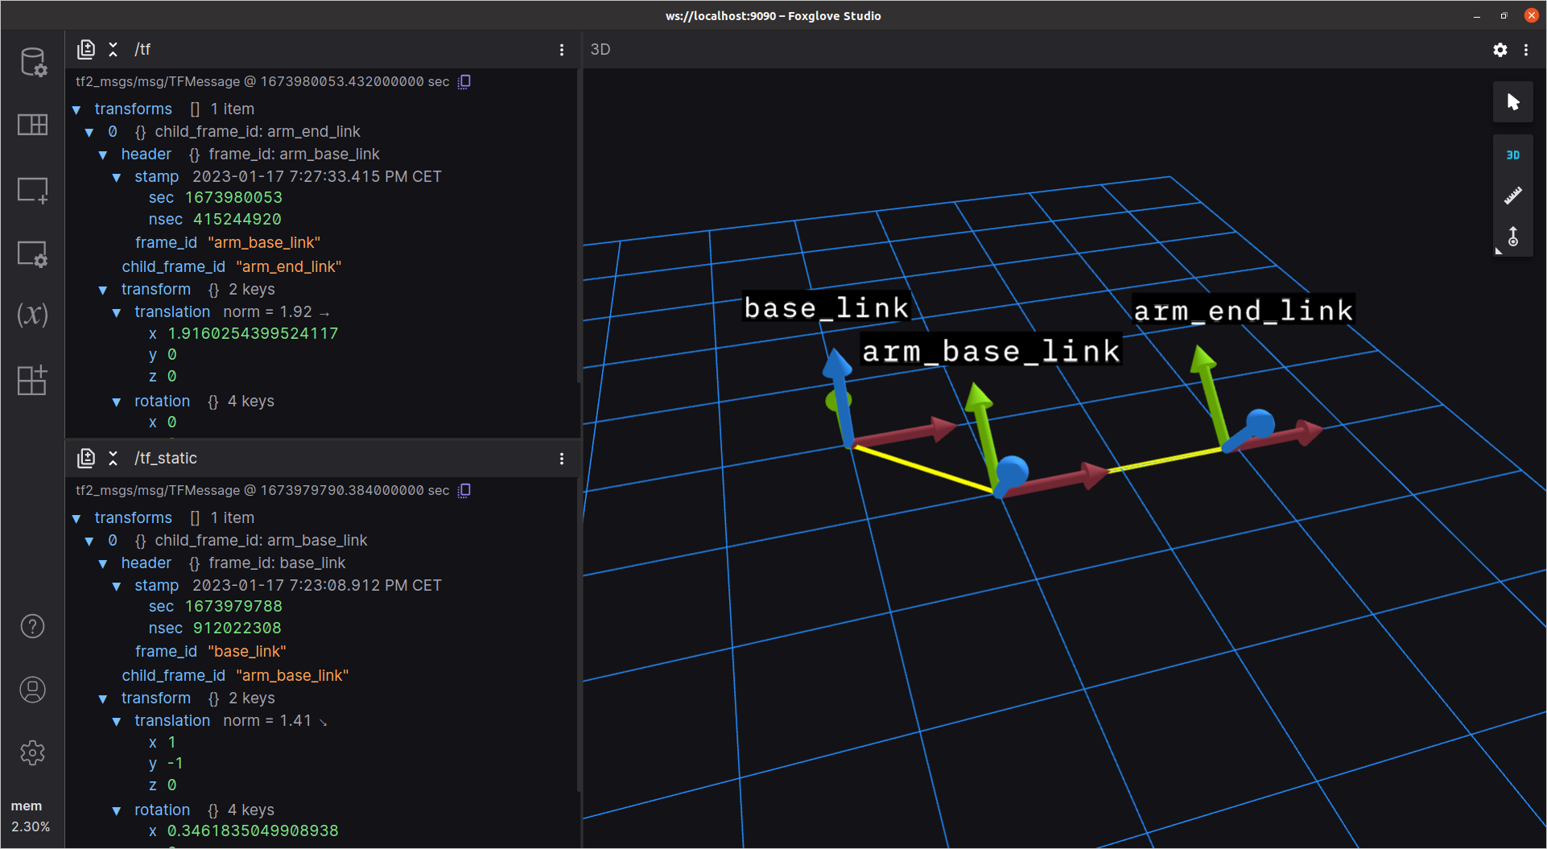
Frame Transformations: ROS TF2

Slide 22
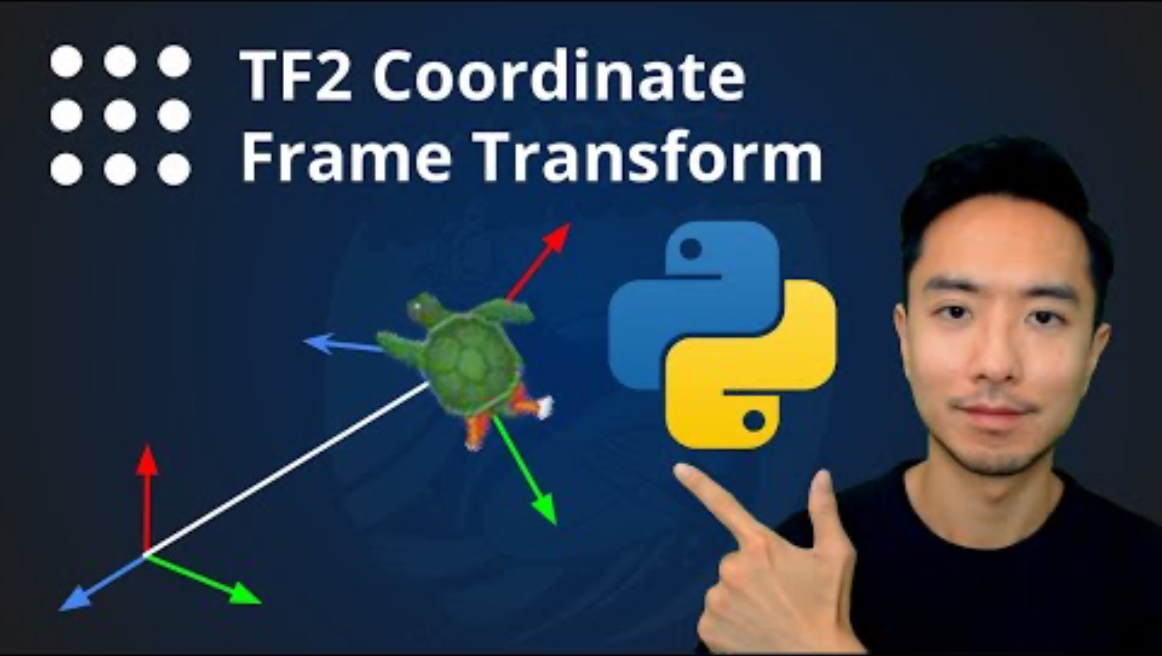
Frame Transformations: ROS TF2

Slide 23
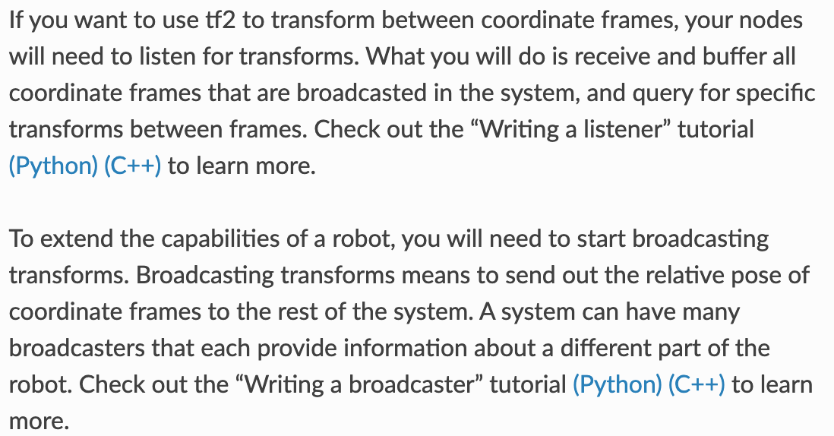
Frame Transformations: ROS TF2

Slide 24
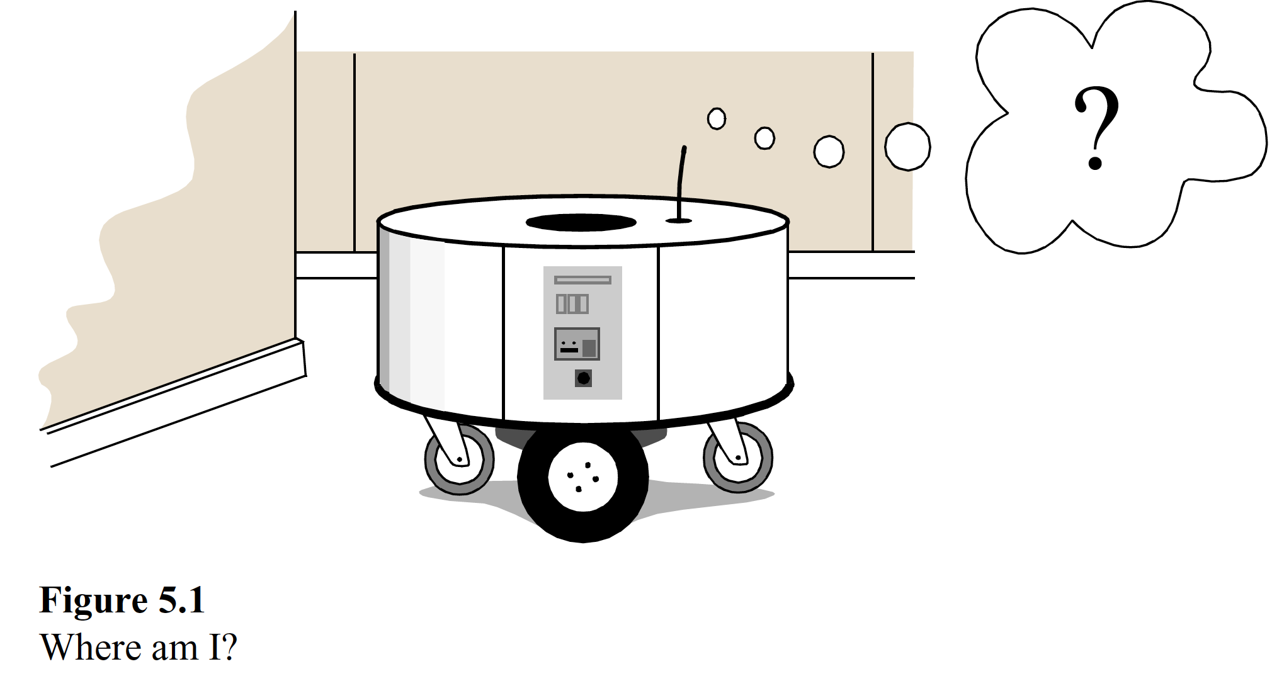
Mapping

Slide 25
Mapping

Slide 26
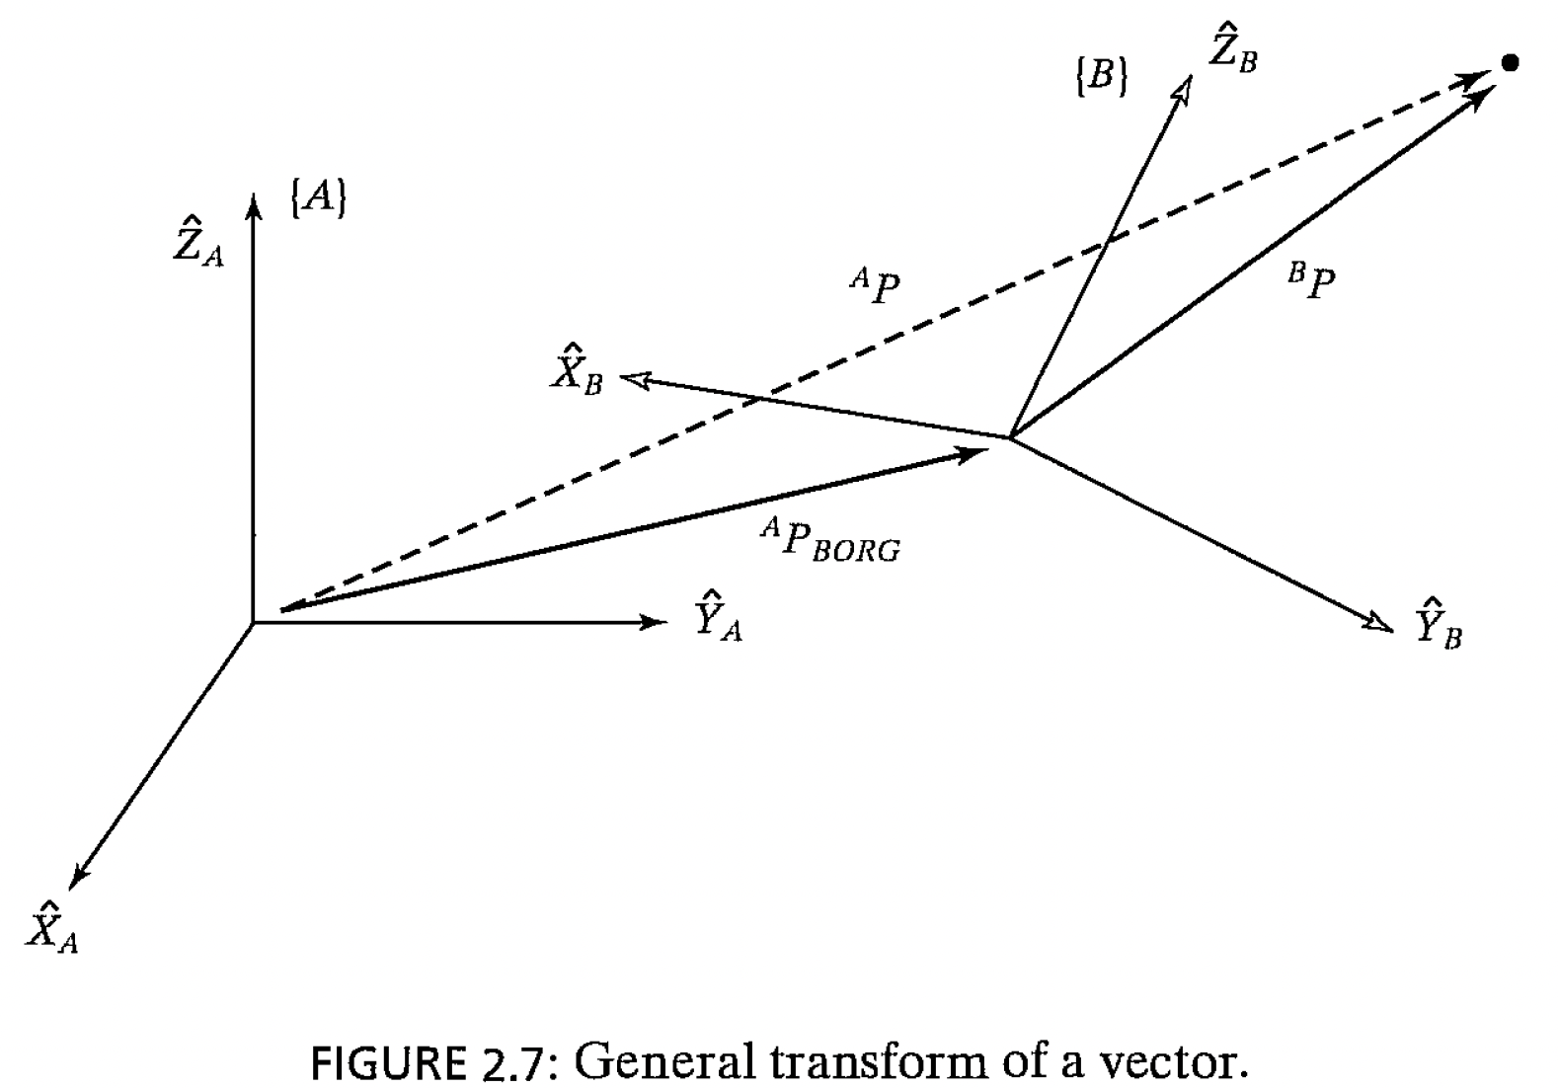
Mapping

Slide 27
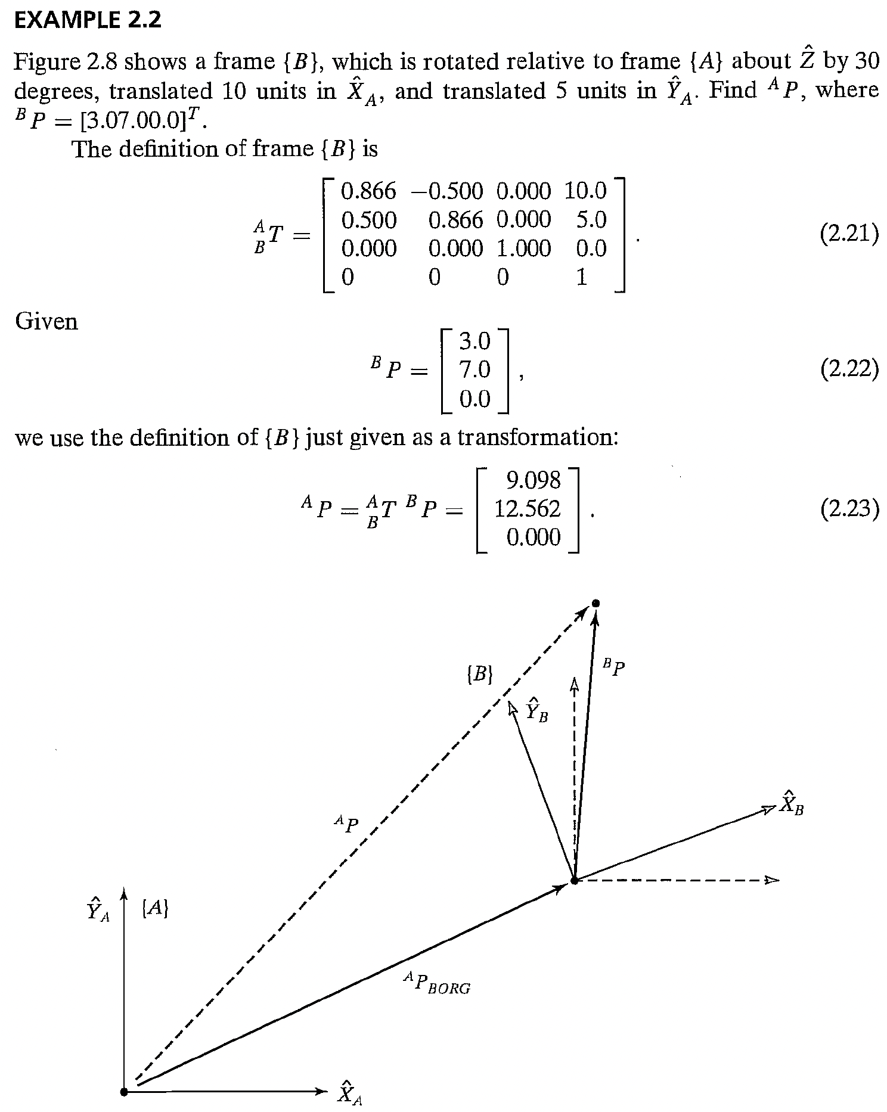
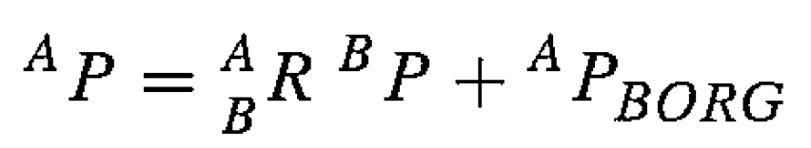
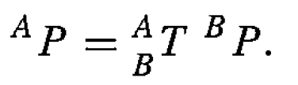
Mapping

Slide 29
Lecture (~45 minutes)
Subsystem check-in (~20 minutes)
Questions?
Questions?
Lecture 1: features, transformations, and mapping
Lecture 2: SLAM

Slide 30
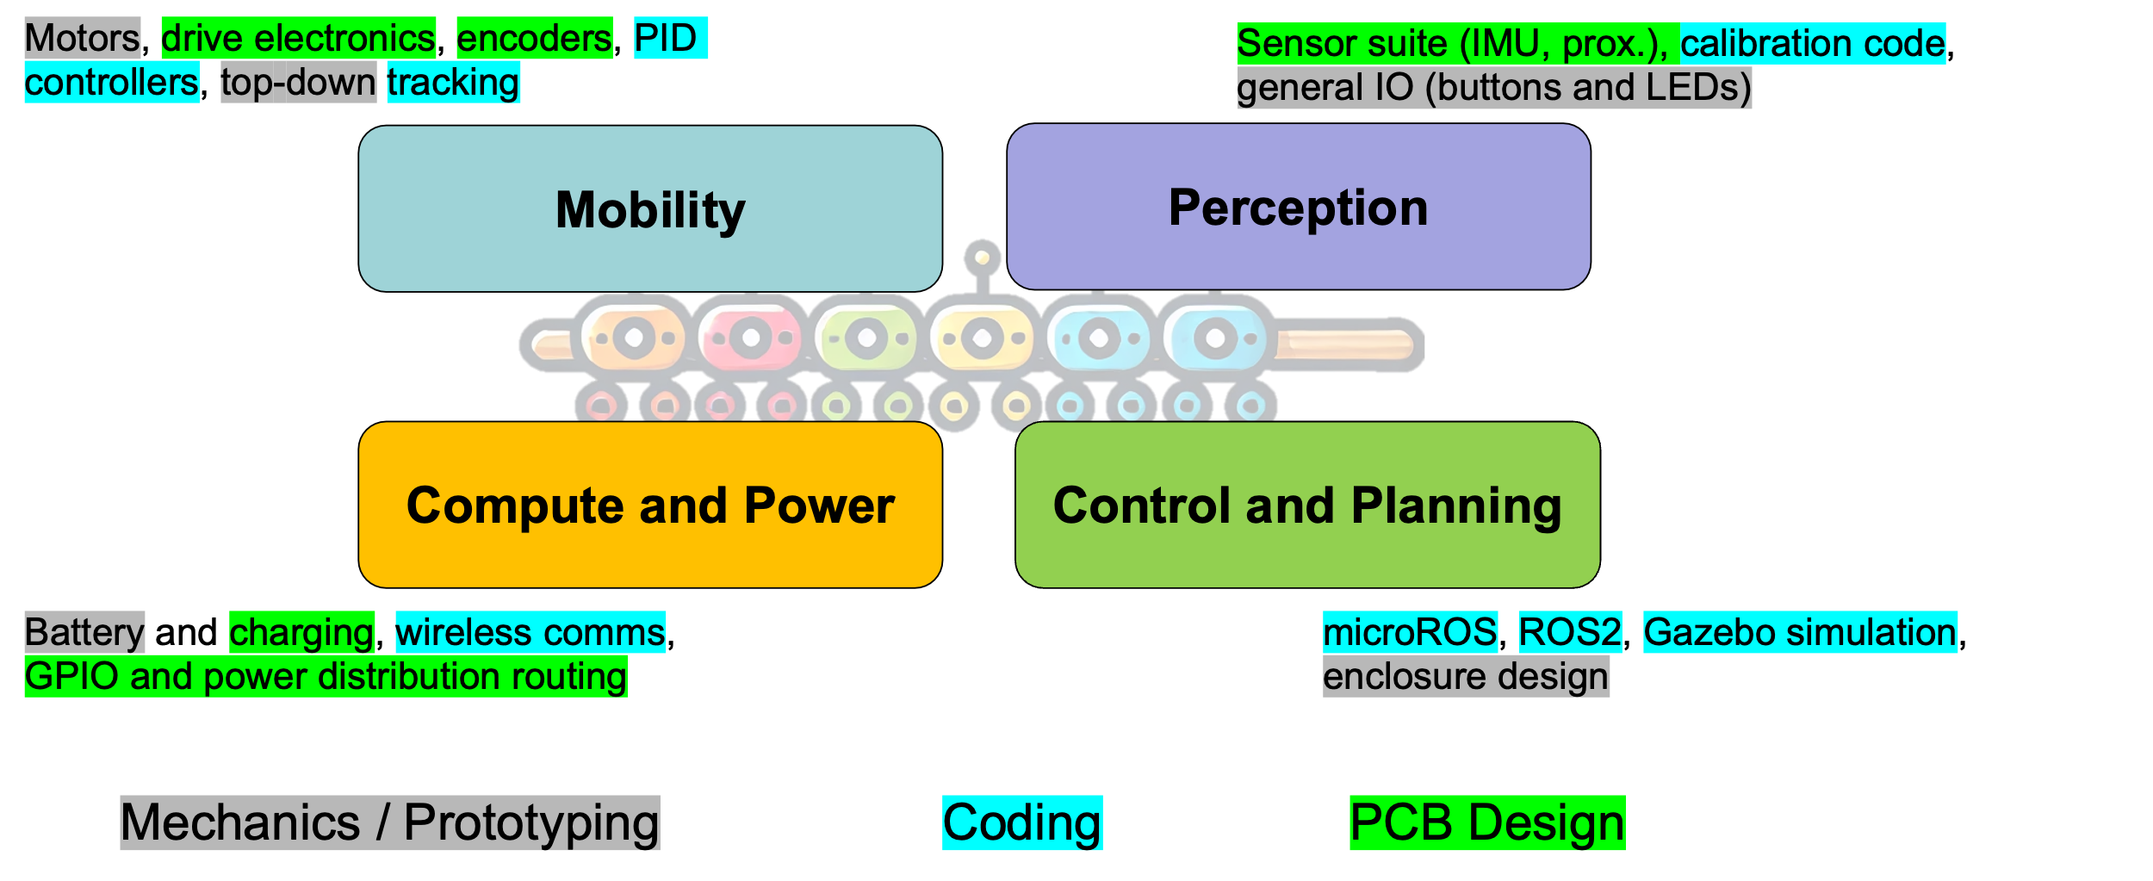
693H Robotic Subsystems
First Design Review Presentations are 2/10, 2/12
-I will randomly select which two groups present which day. Be ready on 2/10.
-Link to presentation templates are posted on Discord + Laulima

Slide 31

693H Robotic Subsystems
Motors, drive electronics, encoders, PID controllers, top-down tracking
Sensor suite (IMU, prox.), calibration code, general IO (buttons and LEDs)
Mobility
Perception
Compute and Power
Control and Planning
Battery and charging, wireless comms, GPIO and power distribution routing
microROS, ROS2, Gazebo simulation, enclosure design
Mechanics / Prototyping
Coding
PCB Design

